Slide 1

Monday Special: Data Mining
Data Science Lifecycle
Week 8 : Web scraping

Slide 2
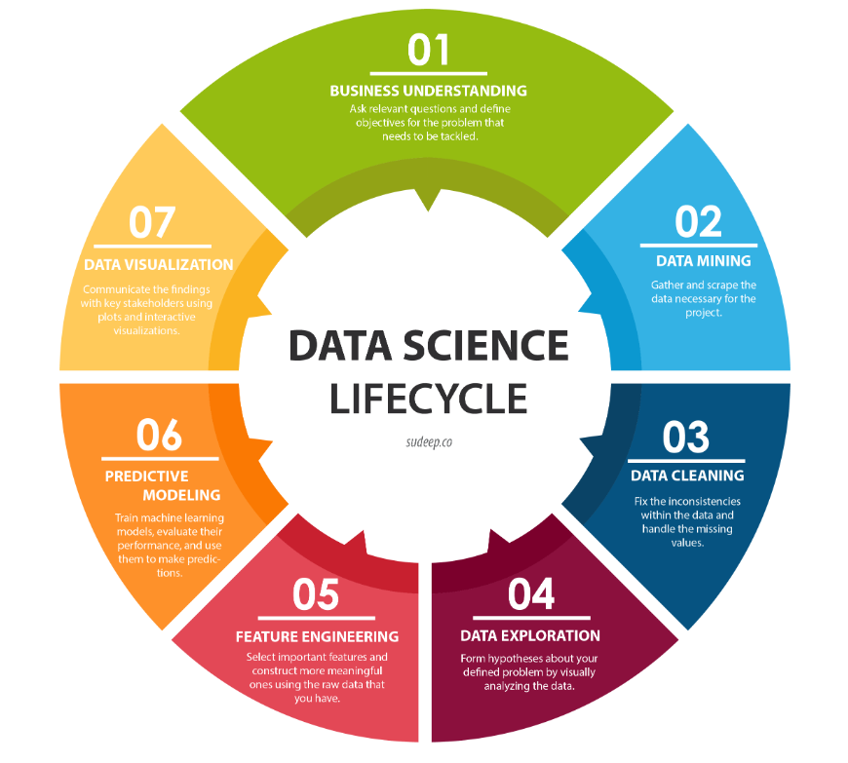
2. Data Mining/ Web Scraping ­◉ Second step of the Data Science life cycle is Data Mining (term being referred to Data Gathering)

Slide 3
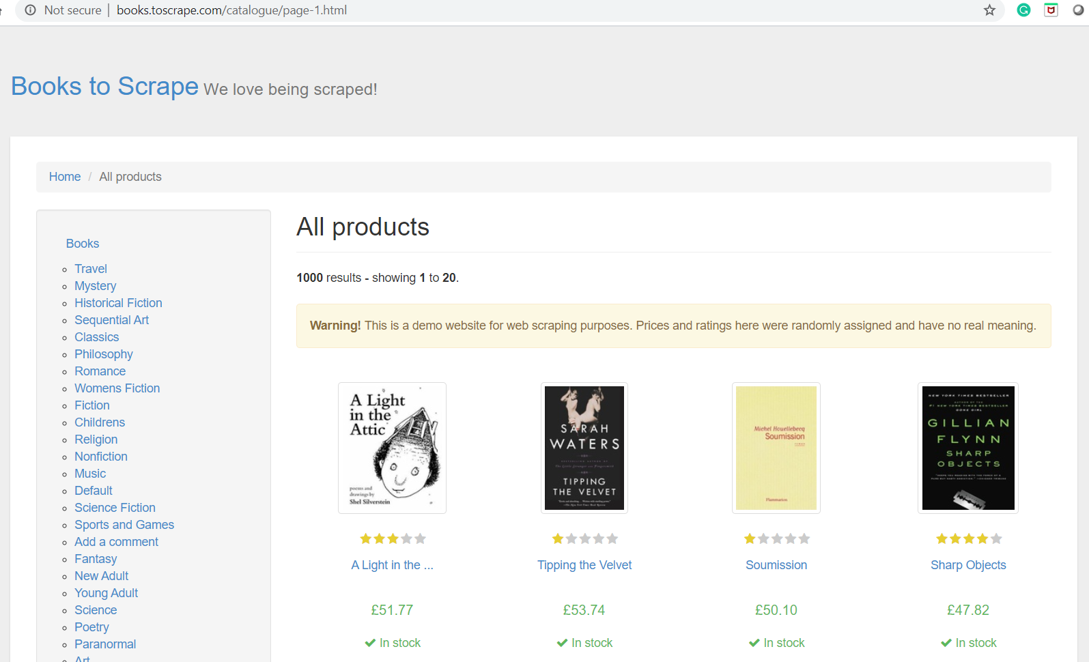
WebScraping
For this Monday Special : Web Scraping exercise using a fictional bookstore website called Books.toscrape.com
This is a demo website for web scraping purposes

Slide 4
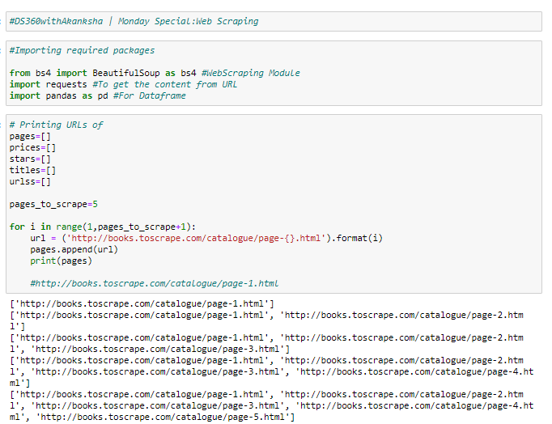
Web Scraping
Started off the web scraping exercise by first importing required packages:
Beautiful Soup
Requests
Pandas

Slide 5
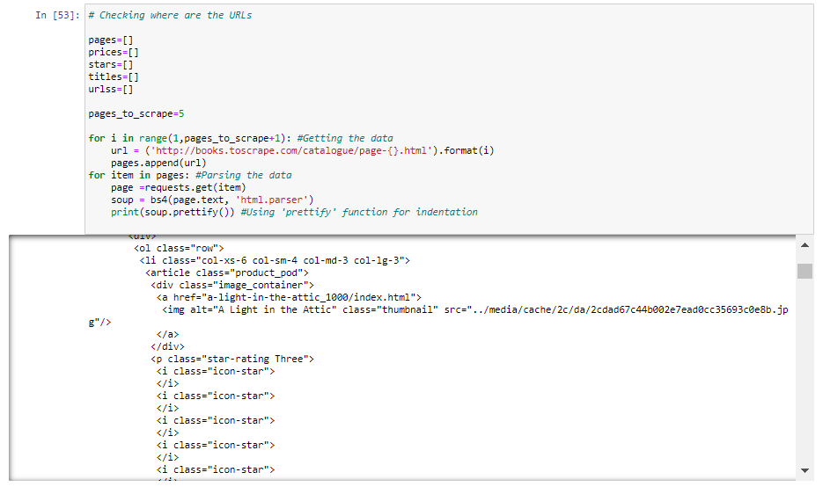
Web Scraping
Next analyzed the html tags to look for desired data points’ tag

Slide 6
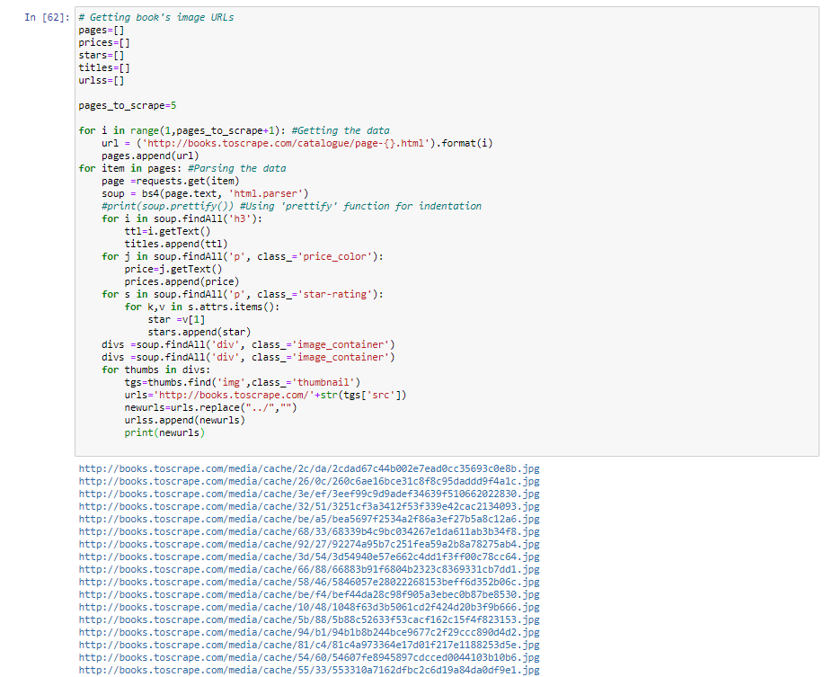
Web Scraping
Looked for tags related to desired datapoints:
Title
Prices
Star Ratings
Image URLs

Slide 7
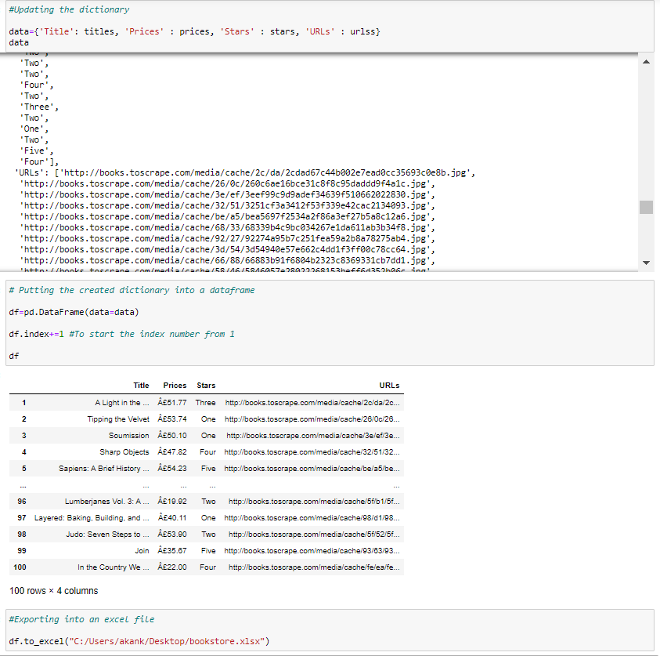
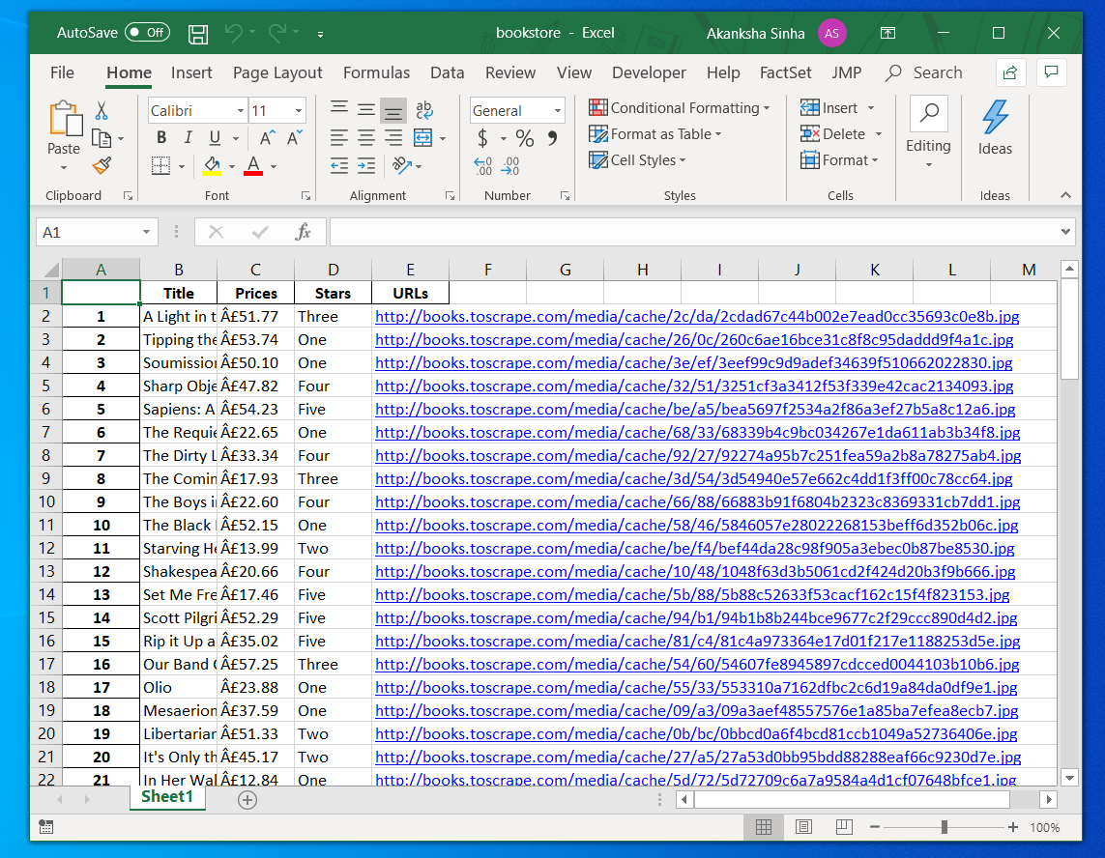
Web Scraping
Collected data related to desired data points (Title, Prices, Stars & Image URLs)
Created a data dictionary to compile all data at one place
Created the dataframe for organized look for collected data
Finally exported the dataframe to an excel sheet

Slide 8
Next Step : 3. Data Cleaning

Slide 9
References
http://sudeep.co/data-science/Understanding-the-Data-Science-Lifecycle/
https://www.youtube.com/watch?v=OVk9tjPfNNU
https://www.crummy.com/software/BeautifulSoup/bs4/doc/
http://books.toscrape.com/
https://towardsdatascience.com/an-introduction-to-web-scraping-with-python-a2601e8619e5

